Slide 1
B-Tree File System
BTRFS
DCLUG
Aug 2009
Przemek Klosowski
File system overview
BTRFS history and design influences
People
Current status
Future

Slide 2
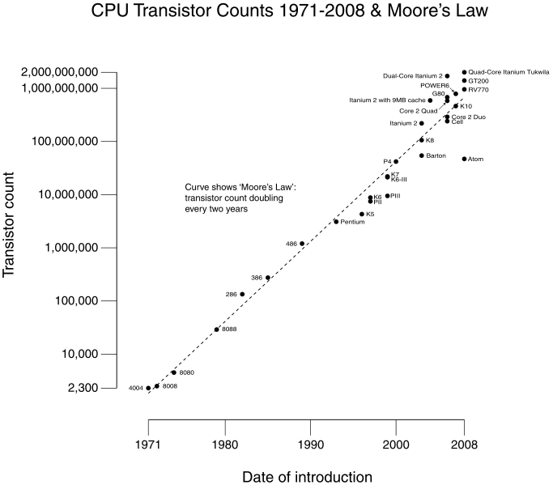
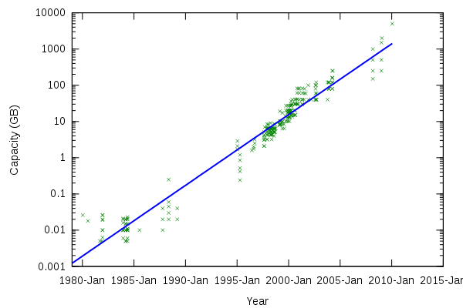
Why file systems are important?
Hard drive access time over time:
4ms
10ms
(by the way, the memory access time isn't much better)

Slide 3
File systems
Design issues
Reliable storage
  Normal usage
  Failure conditions
Fast access
  In different scenarios
Efficient layout
  Small files
  Lots of files
Operational issues
Vulnerability windows
  Log but only meta
  RAID write hole
Recovery (fsck)
Defragmenting
Large directories
Resizing

Slide 4
File systems
Design issues
Reliable storage
  Normal usage
  Failure conditions
Fast access
  In different scenarios
Efficient layout
  Small files
  Lots of files
Operational issues
Vulnerability windows
  Log but only meta
  RAID write hole
Recovery (fsck)
Defragmenting
Large directories
Resizing

Slide 5
File systems we know and love
Granddaddy: Unix FS
Idiot cousin DOS/FAT, and its geek kid NTFS
Our workhorses: EXT{2,3,4}
Special filesystems:
  ISO9660 and UDF for CD/DVDs
  /proc, /swap, /sys, /devfs, UserFS, RAM, union...
  JFFS/UBIFS for flash
  Disconnected operation : Coda, AFS
Innovation: ReiserFS, XFS, ZFS, GFS, OCTFS

Slide 6
Problems to solve
Reliability:
  data loss in software/hardware crashes
  What is journaled?
Performance: intensive I/O, large files, small files, lots of files
  Turns out 100's of IOPS is a lot to ask
Availability: FSCK on a 1TB
Maintainability:
  Backups
  Increasing/decreasing/migrating

Slide 7
BTRFS history
From: Chris Mason <========= Director of Linux Kernel Engineering at Oracle
To: linux-kernel
Subject: [ANNOUNCE] Btrfs: a copy on write, snapshotting FS
Date: Tue, 12 Jun 2007 12:10:29 -0400
Hello everyone,
After the last FS summit, I started working on a new filesystem that
maintains checksums of all file data and metadata. Many thanks to Zach
Brown for his ideas, and to Dave Chinner for his help on
benchmarking analysis.
The basic list of features looks like this:
* Extent based file storage (2^64 max file size)
* Space efficient packing of small files
* Space efficient indexed directories
* Dynamic inode allocation
* Writable snapshots
* Subvolumes (separate internal filesystem roots)
- Object level mirroring and striping
* Checksums on data and metadata (multiple algorithms available)
- Strong integration with device mapper for multiple device support
- Online filesystem check
* Very fast offline filesystem check
- Efficient incremental backup and FS mirroring

Slide 8
Big picture, mid-2007
Linux has multi-TB drives and all, and the following filesystems:
  XFS from SGI, which is on the ropes
  ReiserFS, a killer filesystem ....(sorry)
  Ext3 with a roadmap to Ext4 which is great but ...
SUN has ZFS, but keeps it as a Solaris competitive advantage
Oracle really needs a good Linux filesystem

Slide 9
Big picture, now
BTRFS made nice progress:
  As of 2.6.29 is officially part of the kernel
  Available in Fedora and other distros
Make no mistake, BTRFS is still alpha, not production:
  ENOSPC problems
  Possible incompatible on-disk layout changes
Oracle bought SUN, owns ZFS (heh)
O. bases CRFS (NFS done right?) on BTRFS

Slide 10
OK, what does it mean?
* Extent based file storage (2^64 max file size): That's really big, 18 million TB
* Space efficient packing of small files we aren't wasting space for sub-block files
* Space efficient indexed directories fast access and small directories
* Dynamic inode allocation can't run out of inodes
* Writable snapshots snapshots for backups, duplication,
- Efficient incremental backup and FS mirroring
* Subvolumes (separate internal filesystem roots) FSCK on small chunks, in parallel
- Online filesystem check
* Very fast offline filesystem check
- Object level mirroring and striping
* Checksums on data and metadata (multiple algorithms available) No surprises!!!
- Strong integration with device mapper for multiple device support
REALLY CLEVER

Slide 11
BTRFS design
Everything in the file system - inodes, file data, directory entries, bitmaps, the works - is an item in a copy-on-write (COW) B+tree
B+tree: variation of btree, an efficient n-ary search data structure, invented by Richard Bayer at Boeing in 1971 (B is for 'bushy' or Boeing or Bayer)
COW: a lazy way to keep track of rapidly changing data, by delaying reading/writing until the last minute
  No rewrites in place---doesn't it sound safer?

Slide 12
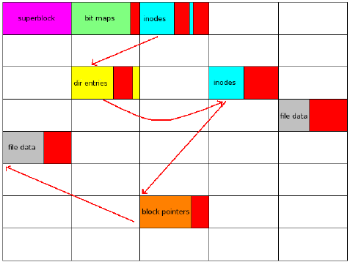
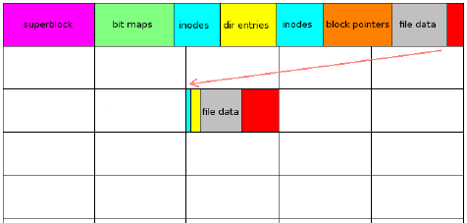
Efficient packing
Traditional
BTRFS
Compare the number of seeks!!!

Slide 13
Migration
OK, this is really cool:
Can migrate from EXT to BTRFS
In place!!!
And back again!!!
How?
BTRFS metadata in EXT 'free' space and vice versa; snapshot preserves it as 'free'
I don't understand it fully either :)

Slide 14
References
BTRFS history, by Val Hanson: http://lwn.net/Articles/342892/
Main Wiki page: http://btrfs.wiki.kernel.org
EXT-BTRFS conversion: http://btrfs.wiki.kernel.org/index.php/Conversion_from_Ext3
Wikipedia: http://en.wikipedia.org/wiki/Btrfs
http://www.caiss.org/docs/DinnerSeminar/TheStorageChasm20090205.pdf
http://en.wikipedia.org/wiki/Comparison_of_file_systems
Oracle Coherent Remote FS: http://oss.oracle.com/projects/crfs/

